Slide 1

HDSC Summer ‘22 Premiere Project Presentation: Weather Prediction Saturday 27th of August, 2022

Slide 2


Our Team
Presenter 1
Other Active Members
Joshua Owoicho
Habeeb Oseni
Chukwudi Percy
Enukoha Chinazom
Jude Ejepu
Mugumya Twarik
Harouna
Fachi Okolo aldou
Akshay Pratap Singh
Project Lead
Solomon Nwkor
Assistant Project Lead
Ibrahim Ogunbiyi
Querry Analyst
Olu Abiodun
Ibrahim Ogunbiyi
Presenter 2
Daniel Kurui

Slide 3

Introduction
Weather prediction and forecasting is the application and combination of various scientific and technological concepts to predict the atmospheric condition of any place at a given time.
Weather forecasting plays an important role in our daily lives, from farmers in the agricultural industry, pilots in airspace navigation, athletes, artists, and understanding renewable energy..

Slide 4
Problem statement
We aim to solve the problem of inaccurate weather predictions by forecasting the average temperature of New York City using traditional machine learning algorithms.

Slide 5

Existing Solutions
To this end, we decided to train and test our model, using various permutations to illustrate signal processing concepts such as filtering, Fourier transform, auto-correlation, cross-correlation.

Slide 6
Our Approach
Use time series analysis to predict the temperature readings for NYC

Slide 7
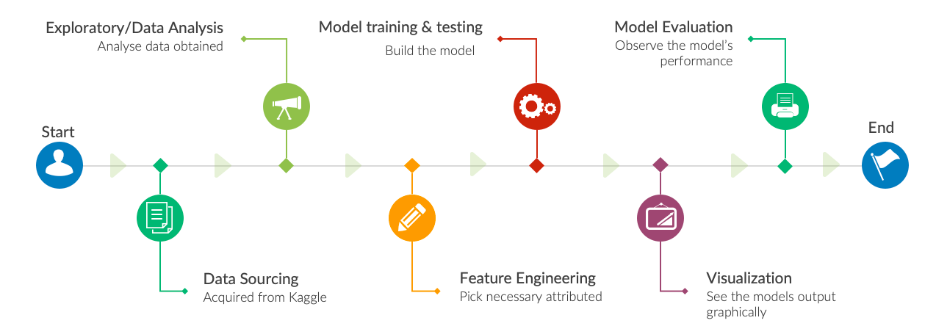
Project work flow diagram

Slide 8
Dataset Description
Dataset Definition, Source and Features
The weather prediction for this project is based off on past identified dataset of various weather attributes such as temperature, humidity, air pressure from about 36 cities across Canada, Israel, and the United States and was obtained from kaggle public datasets
Temperature attribute data of New York city from the preprocessed dataset was employed for this project
The temperature weather attribute had 45253 entries with 793 null values.
"datetime" and "temperature" are the only fields -a time series problem
Readings were given in absolute values rather than degree Celsius

Slide 9

Exploratory Data Analysis
Cleansing and Data Processing
The null values of dataset were filled using forward and backward filling techniques.
The dataset was then transformed to include days, months, and years.

Slide 10
Descriptive Statistics
The minimum and maximum temperature in New York between 2012 and 2017 was 250.77k and 310.24k respectively
The average temperature was 285.40K, representing a low temperature in New York.
count | 44460.000000
mean | 285.400406
std | 10.220932
min | 250.774000
25% | 277.370000
50% | 285.870000
75% | 293.760000
max | 310.240000

Slide 11
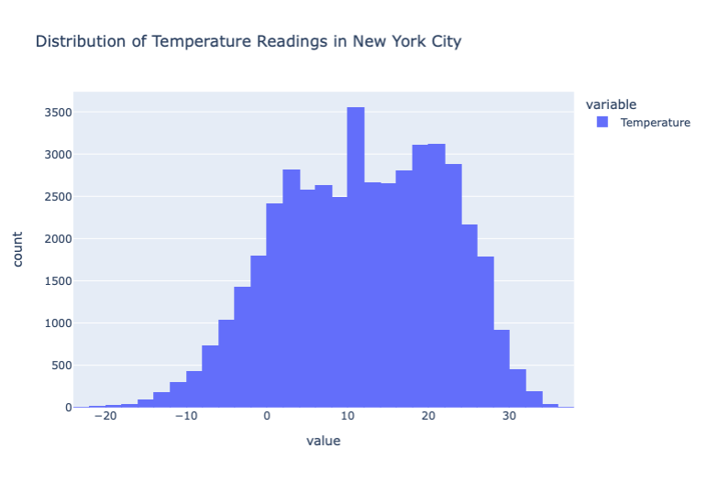
Representation of the normal distribution properties of our temperature attribute.
The shape of the temperature attribute follows a normal distribution curve, conveying that it possesses a uniform seasonal change, and confirming its time series properties.

Slide 12
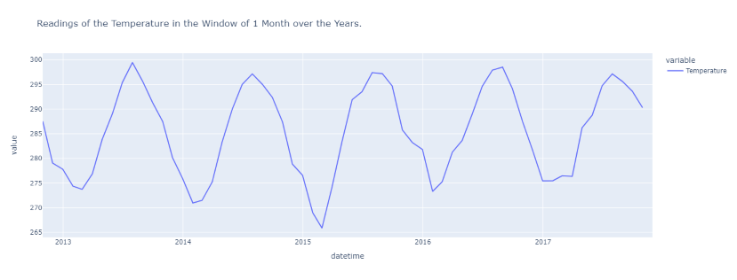
lowest temperatures were between Feb and March 2015, with an overall upward trend. Highest in July
Plot of temperature readings ranging 2012 to 2017
The shape of the temperature dataset reveals that it possesses a uniform seasonal change, thereby confirming its time series properties.

Slide 13
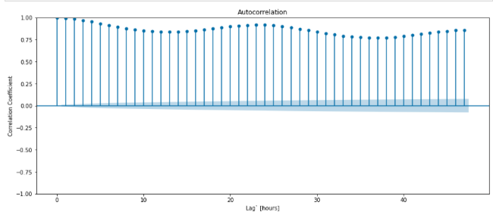
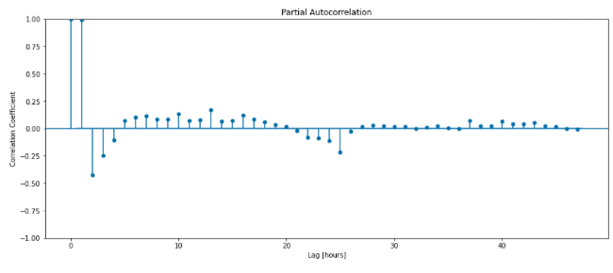
Model Training
Autocorrelation
it is statistically significant and autocorrelated against its own lag as the autocorrelation function tested by model is very close to one
Partial AutoCorrelation Coefficient
The model tests the partial correlation coefficient of temperature of New York city revealing that the model is statistically significant as partial correlation coefficient function after the first 2 lags is very low.

Slide 14
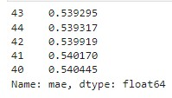
Model Building, Evaluation and Hyperparameter Tuning
We trained our data using AutoRegressive
Model (AR) and used walk forward validation to build run last prediction.
We got the lowest mean absolute error (best fit model) with the best set of hyperparameters after 44 iterations of hyperparameters tuning while using the 43rd iteration.

Slide 15
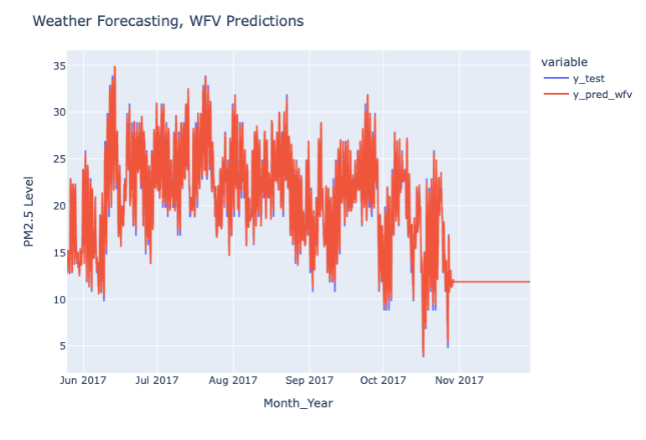
Model
The mean absolute error of the model is
calculated as 0.3693 and R2 score gave a 99% accuracy report on the model.

Slide 16
Summary
The dataset reveals that on the 20th of July 2013, the temperature was at its third hottest in the history of New York city, conversely the temperature in New York was at the lowest on 20th of February 2015.
The effects of global warming and climate change are seen all over the city of New York and by extension the World.
Challenges faced during the project were:
Deciding on the appropriate research question
Ensuring that all team members participate in the project
Time constraints to test for advanced model

